Slide 1
New York State
Voter Dropout Analysis
Solomon Gaim
MS Data Science
Jason Yoo
BS Data Science
Nilesh Patil
MS Data Science
Notes:
N

Slide 2
Outline
01
Problem Statement
02
Data Description & Methodology
03
Data Processing
04
Results & Visualization
05
Future Work
Notes:
J/N

Slide 3
Problem Statement
Removed
Eligible to vote
Total Voters
Voted in 2016
6 million
Focus on purged voters to identify reasons & patterns in purging
8 million
2016 presidential election vote count
11 million
Focus on identifying voters where status update is likely
17 million
Total registered voters on the New York State voter list
ACTIVE, INACTIVE, PURGED, 17(PREREGISTERD 17 Year Olds)
Notes:
J

Slide 4
Data Description & Methodology
Structure
Features
Received flat files from Lacey, our sponsor at the AG’s office
Each observation represents one voter in New York State since 2002
Granularity of the dataset is at zip code level
We have in total 45 features
Features are mostly nominal in nature
Voting history is given as a string of election names in which a voter actually voted
Approach
Missing
Analysis of counts
Grouping by informative features representing current status, location etc
Feature engineering for age, voting history, purge information
Most features are sparse & some have >90% missing values
We believe that this is due to most fields being voluntary during data collection and so, most voters skip this info
~4 million voters have never voted since 2002
LASTNAME | FIRSTNAME | MIDDLENAME | NAMESUFFIX | RADDNUMBER | RHALFCODE | RAPARTMENT | RPREDIRECTION | RSTREETNAME | RPOSTDIRECTION | ... | REGDATE | VRSOURCE | IDREQUIRED | IDMET | STATUS | REASONCODE | INACT_DATE | PURGE_DATE | SBOEID | VoterHistory
BUNZEY | MARCIA | R | NaN | 434 | NaN | NaN | NaN | CLOVE RD | NaN | ... | 19811002 | MAIL | N | Y | ACTIVE | NaN | NaN | NaN | NY000000000008503025 | 11/8/2016 General Election;2014 GENERAL ELECTI...
Notes:
J/S

Slide 5
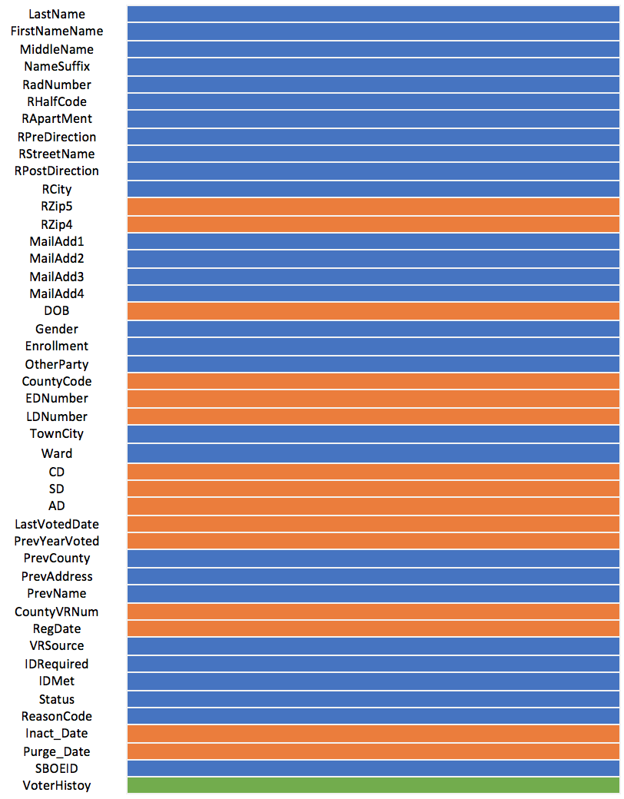
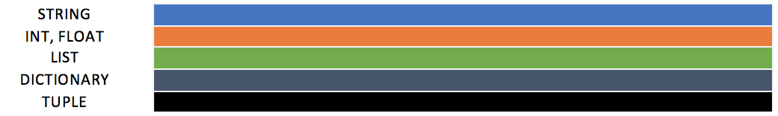
Data Types
Notes:
J

Slide 6
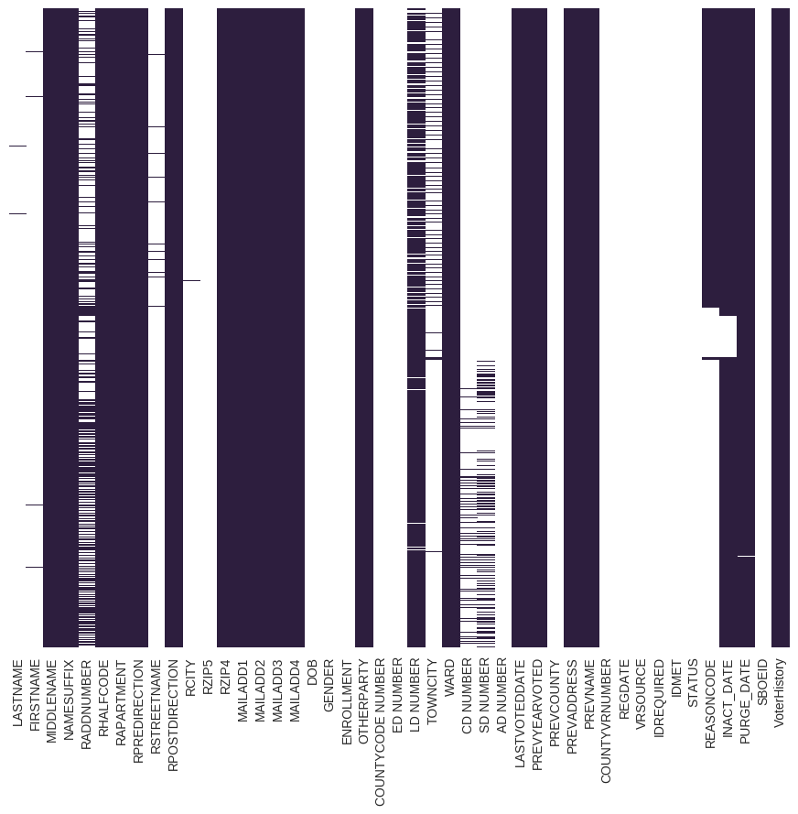
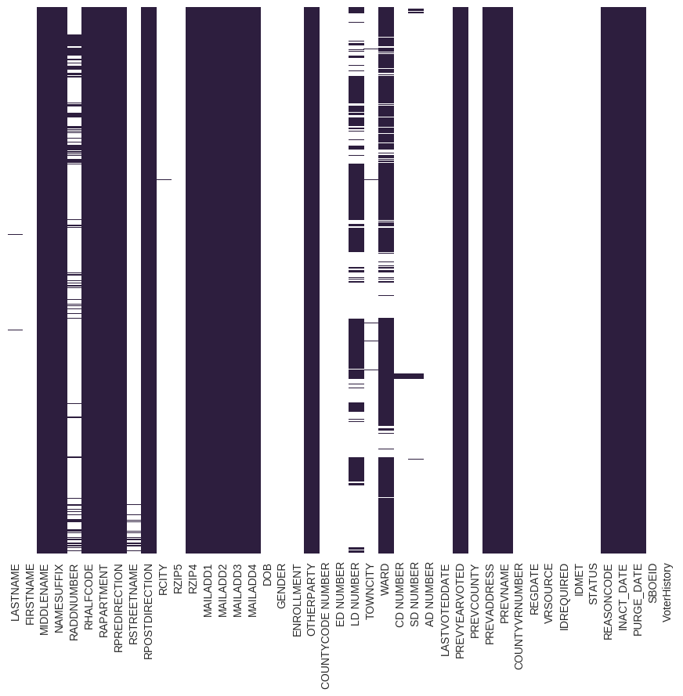
Missing Values
voting history = NULL
voting history != NULL
4 Million : 2 Active
13 Million : 10 Active
Notes:
S

Slide 7
Data Processing: Feature Creation
Raw data
Active
Common Variable
Inactive
Current_Age, Year_Since_Voted
Purge Year Count, Binary_Years
Years, Age_At_Purge
Data anomalies
DOB (<0, 100+)
Registration dates

Slide 8
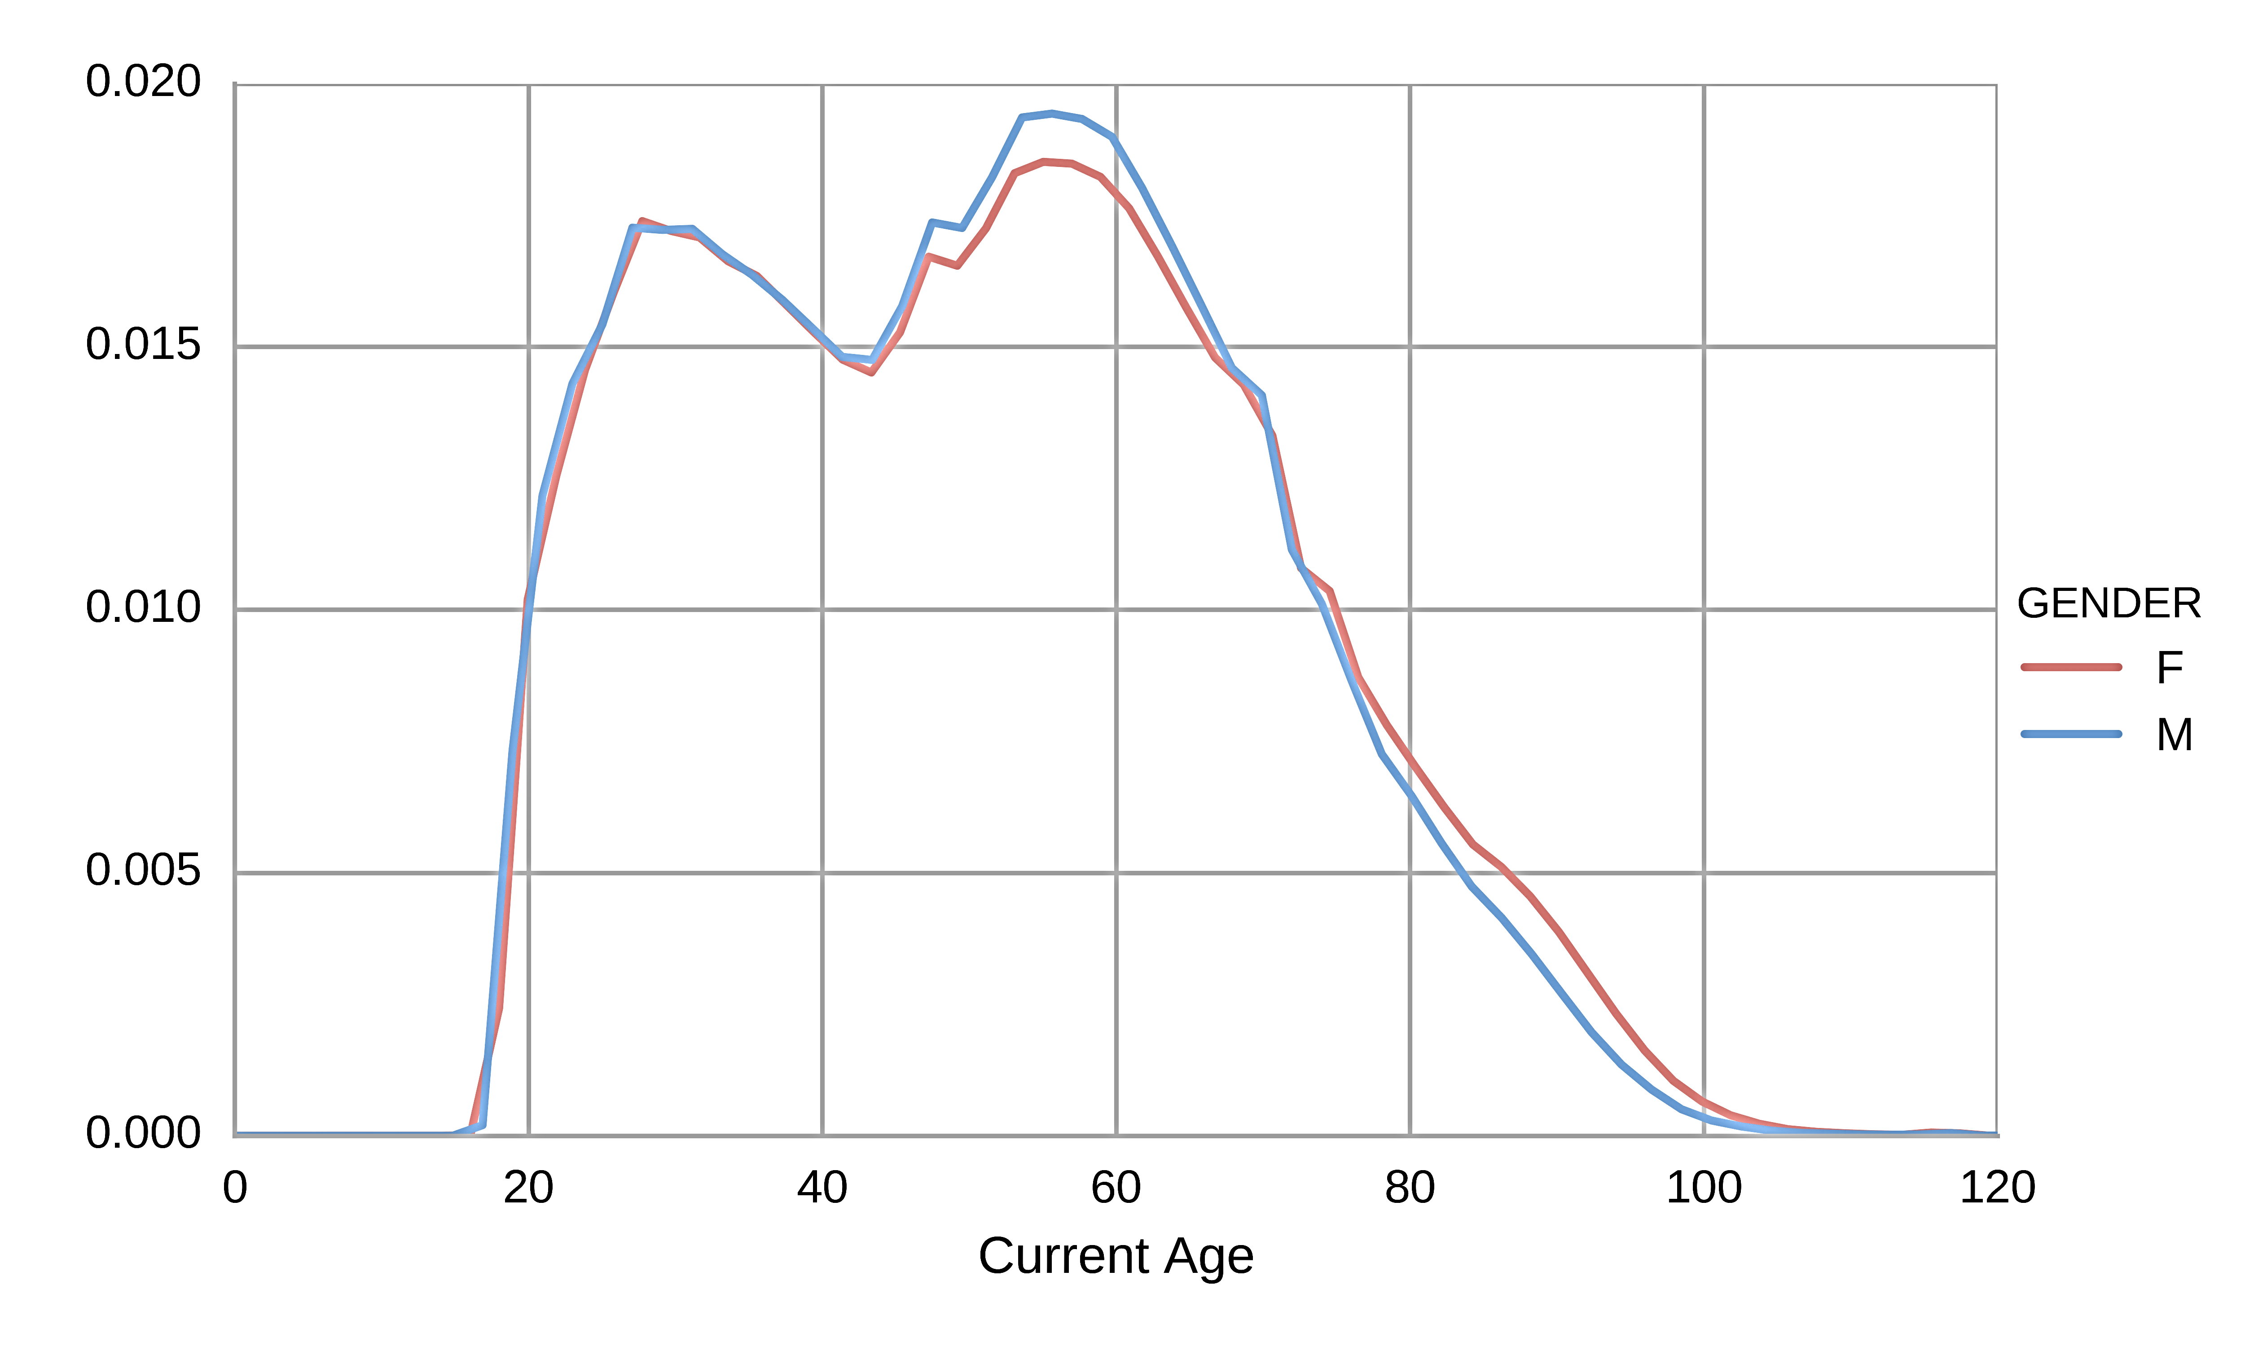
Distribution of current voters – by age
Bimodal : Below ~40 and above ~45
Notes:
S

Slide 9
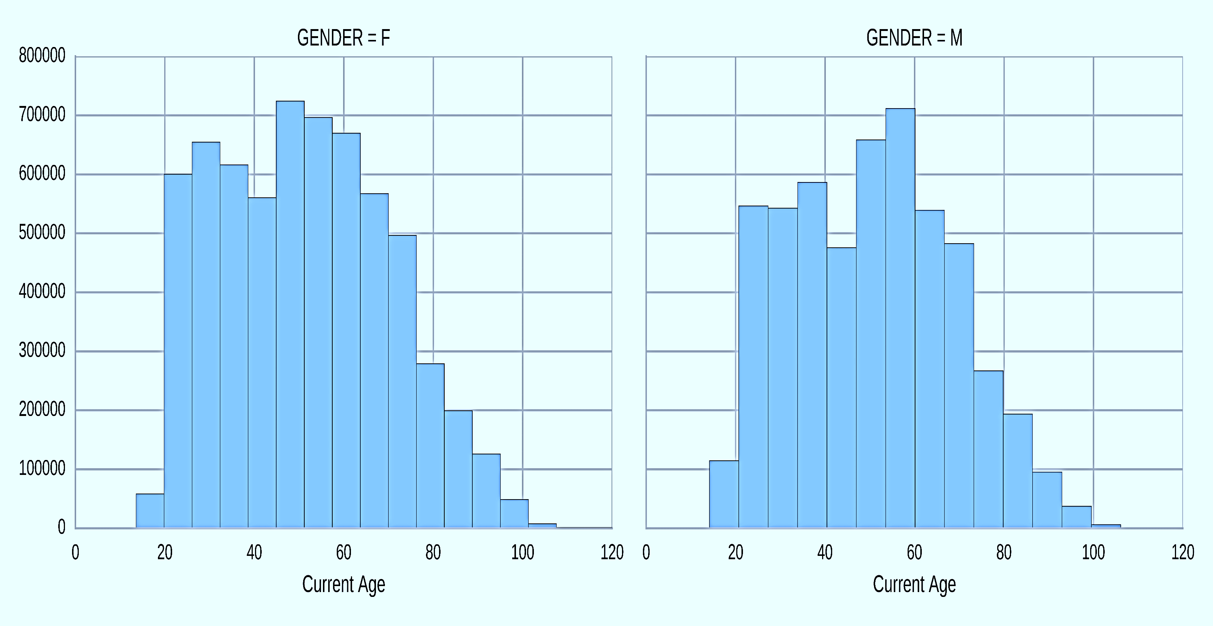
Distribution of current voters – by age
Bimodal : Below ~40 and above ~45
Notes:
S

Slide 10
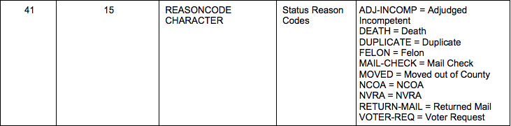
Purging
10 possible reason for a voter being dropped.
Most reason codes are not seen in the dataset.
Duplicate, Felon, NCOA, NVRA, and ADJ-INCOMP, and Mail-check
Useful reason codes:
Moved, Court, Death, Other

Slide 11
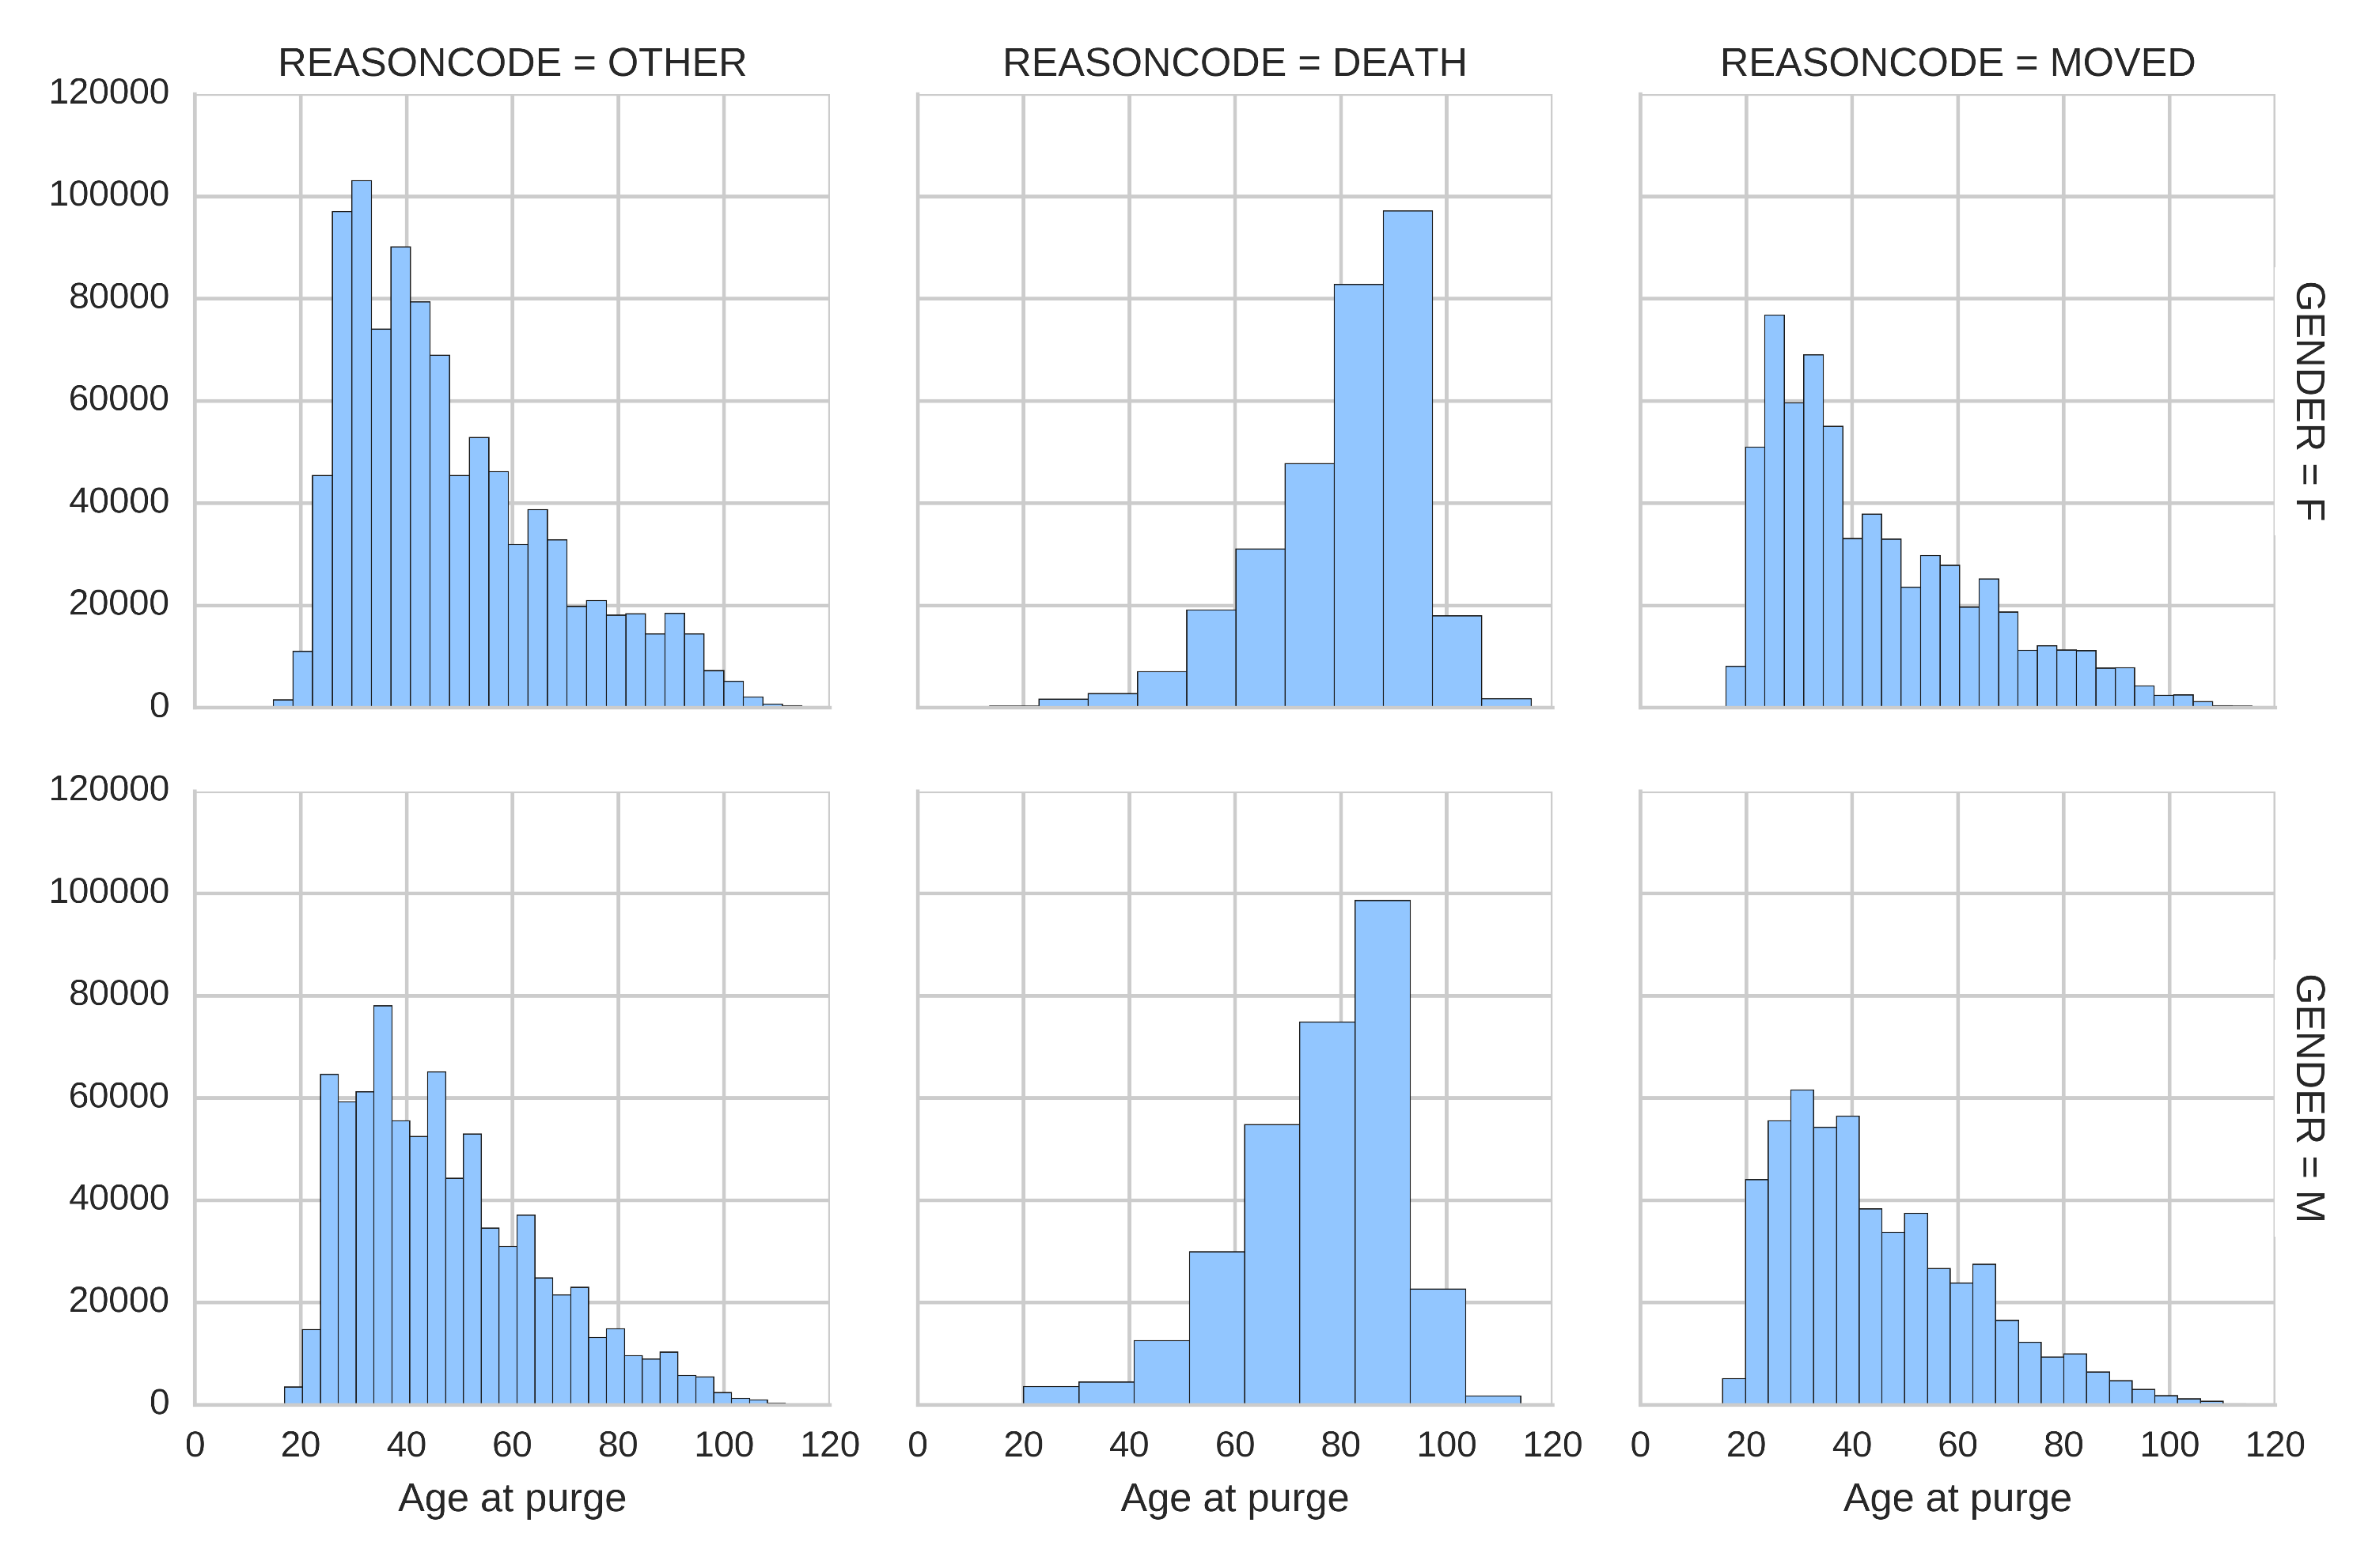
Purged Voters – by age at purge
There are 3 main reasons for removing voters from the active list
Notes:
S

Slide 12
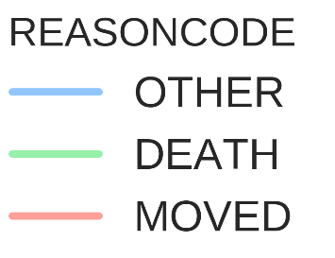
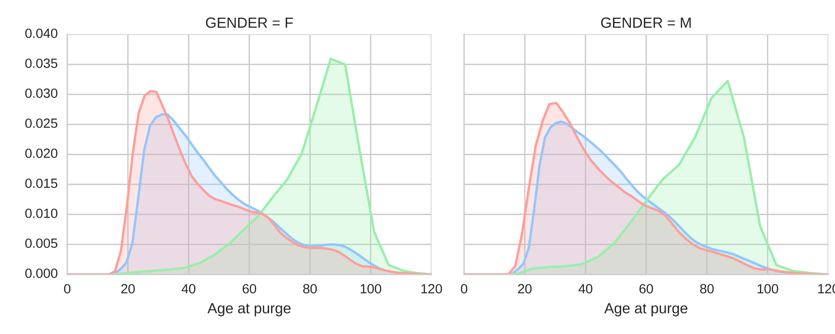
Purged Voters – by age at purge
There are 3 main reasons for removing voters from the active list
Notes:
S

Slide 13
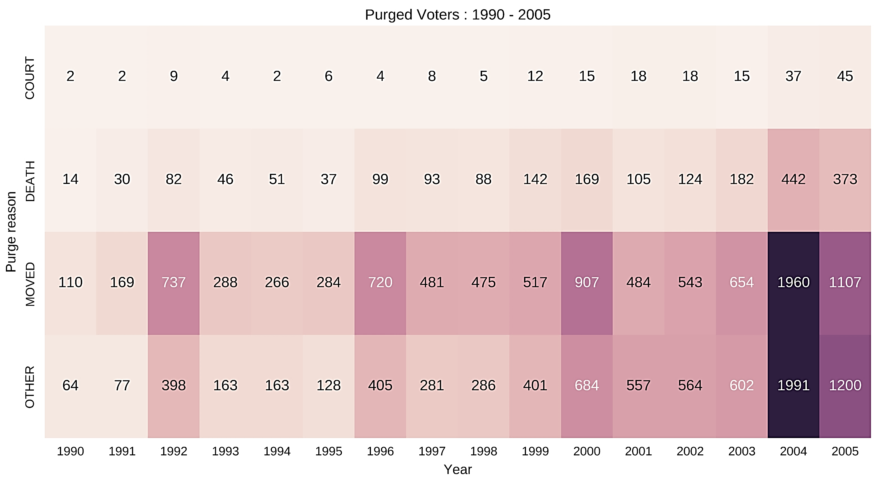
Purging over the years
Notes:
S

Slide 14
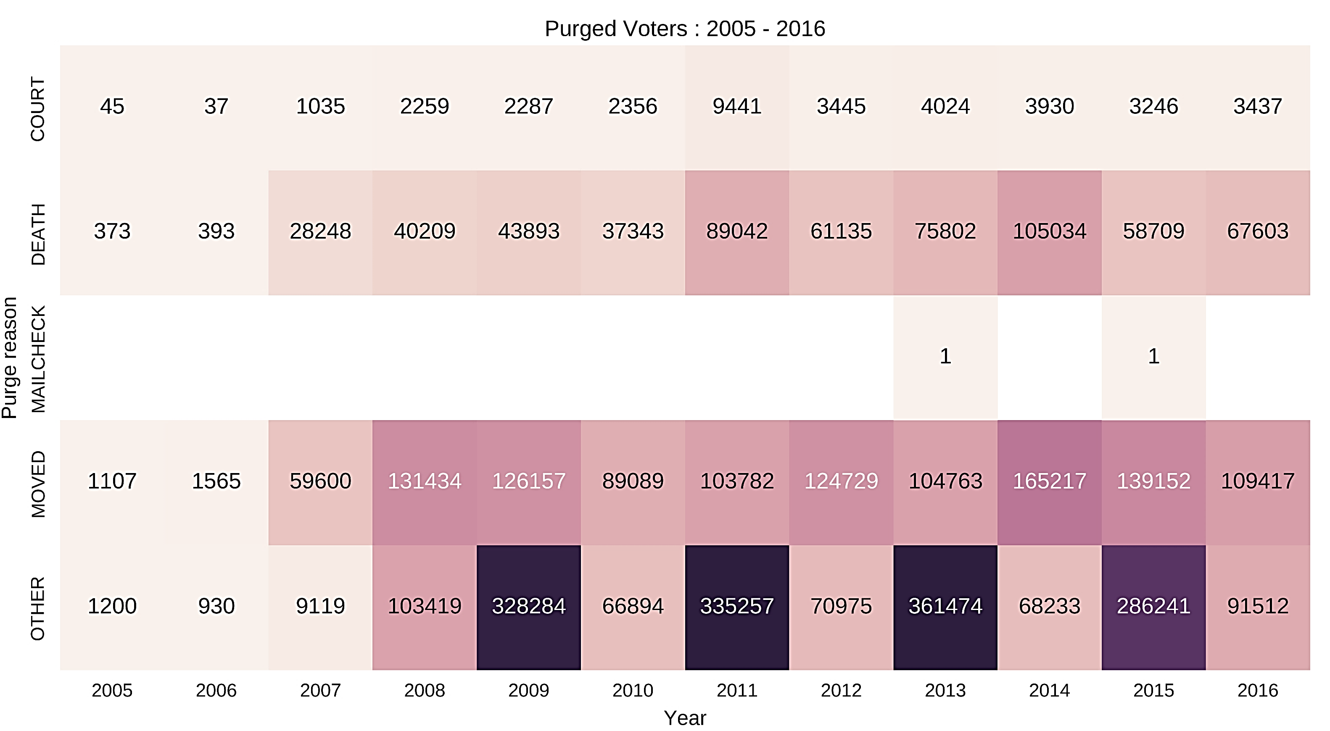
Purging over the years
Frequent list updates since 2007
The biennial trend
Notes:
S

Slide 15
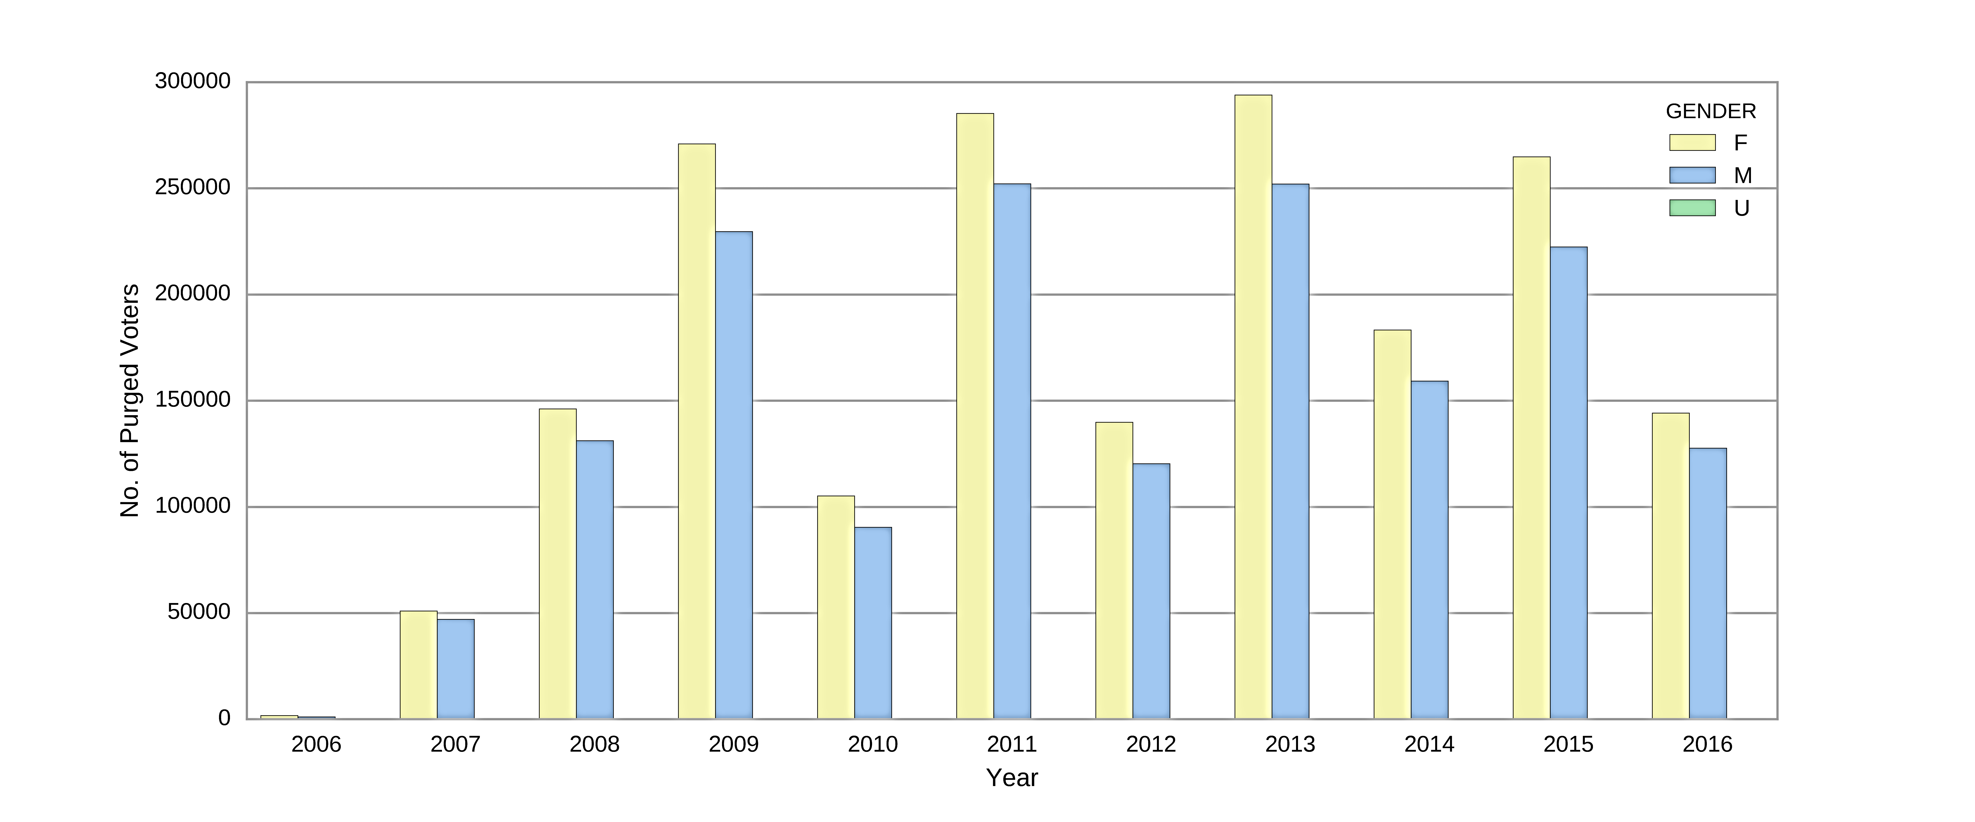
Purged Voters for each year by gender
~50,000 difference between genders every year
Biennial trend
Notes:
S

Slide 16
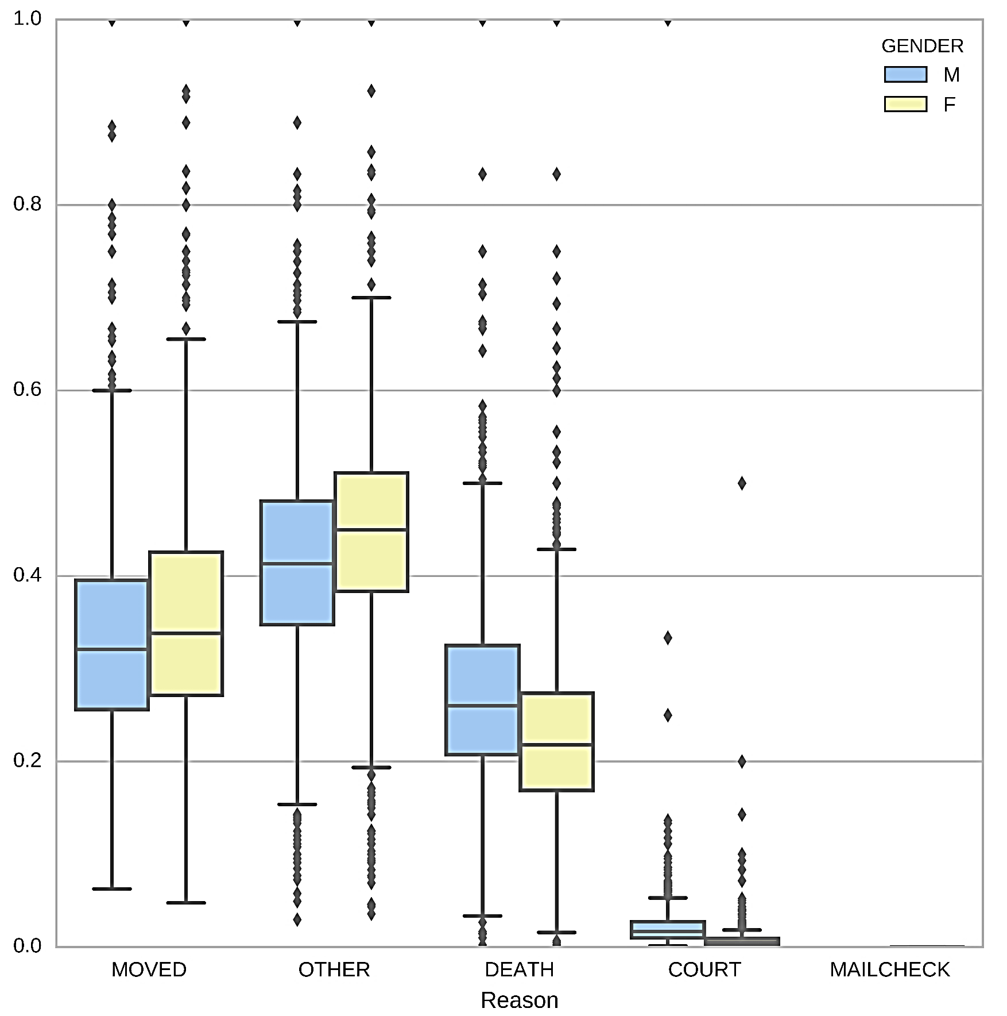
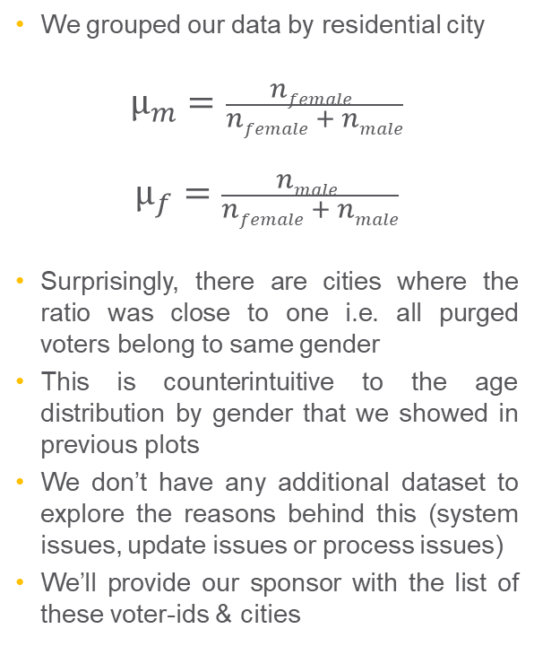
Purging differences by city
We grouped our data by residential city
$$µ_{m}=\frac{nfemale }{nfemale + nmale}$$
$$µ_{f}=\frac{nmale }{nfemale + nmale}$$
Surprisingly, there are cities where the ratio was close to one i.e. all purged voters belong to same gender
This is counterintuitive to the age distribution by gender that we showed in previous plots
We don’t have any additional dataset to explore the reasons behind this (system issues, update issues or process issues)
We’ll provide our sponsor with the list of these voter-ids & cities
µ
Notes:
N

Slide 17
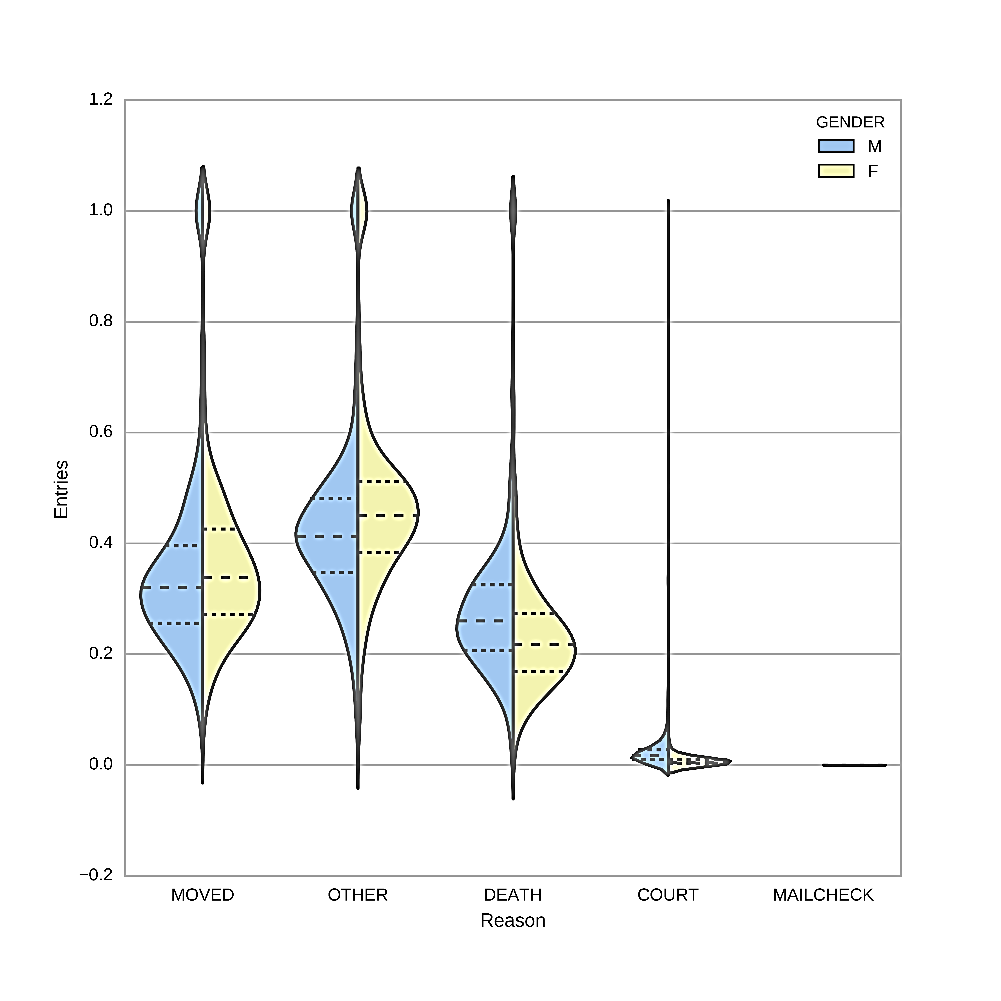

Purging differences by city
We grouped our data by residential city
$$µ_{m}=\frac{nfemale }{nfemale + nmale}$$
$$µ_{f}=\frac{nfemale }{nfemale + nmale}$$
Surprisingly, there are cities where the ratio was close to one i.e. all purged voters belong to same gender
This is counterintuitive to the age distribution by gender that we showed in previous plots
We don’t have any additional dataset to explore the reasons behind this (system issues, update issues or process issues)
We’ll provide our sponsor with the list of these voter-ids & cities
µ

Slide 18
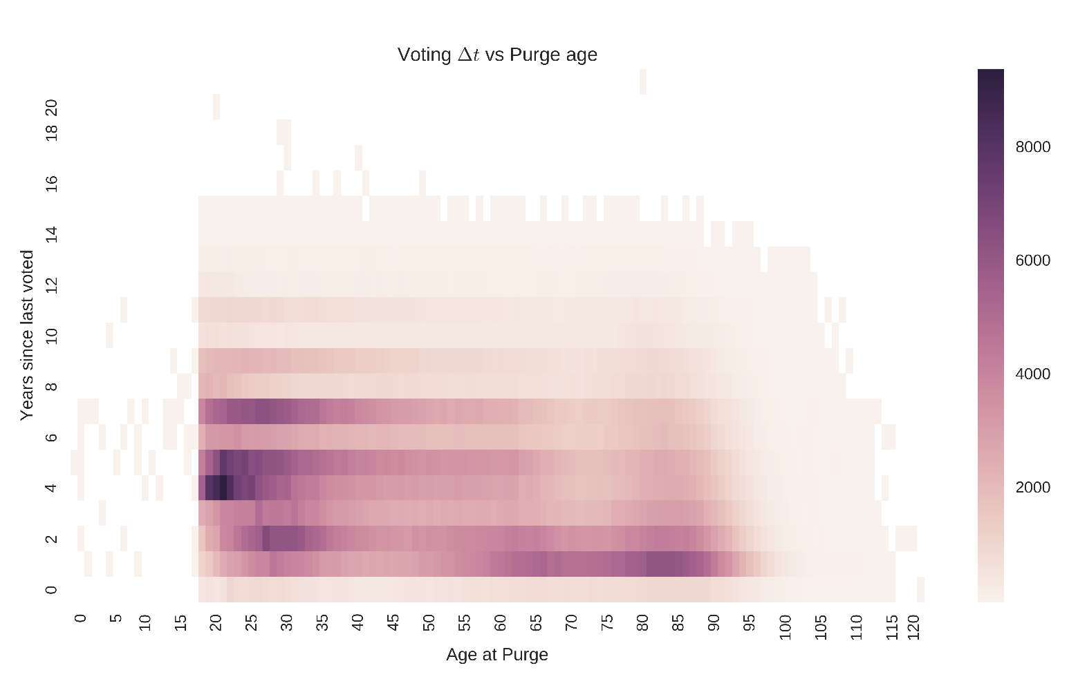
Purged Voters
Years since last vote vs age at purge

Slide 19
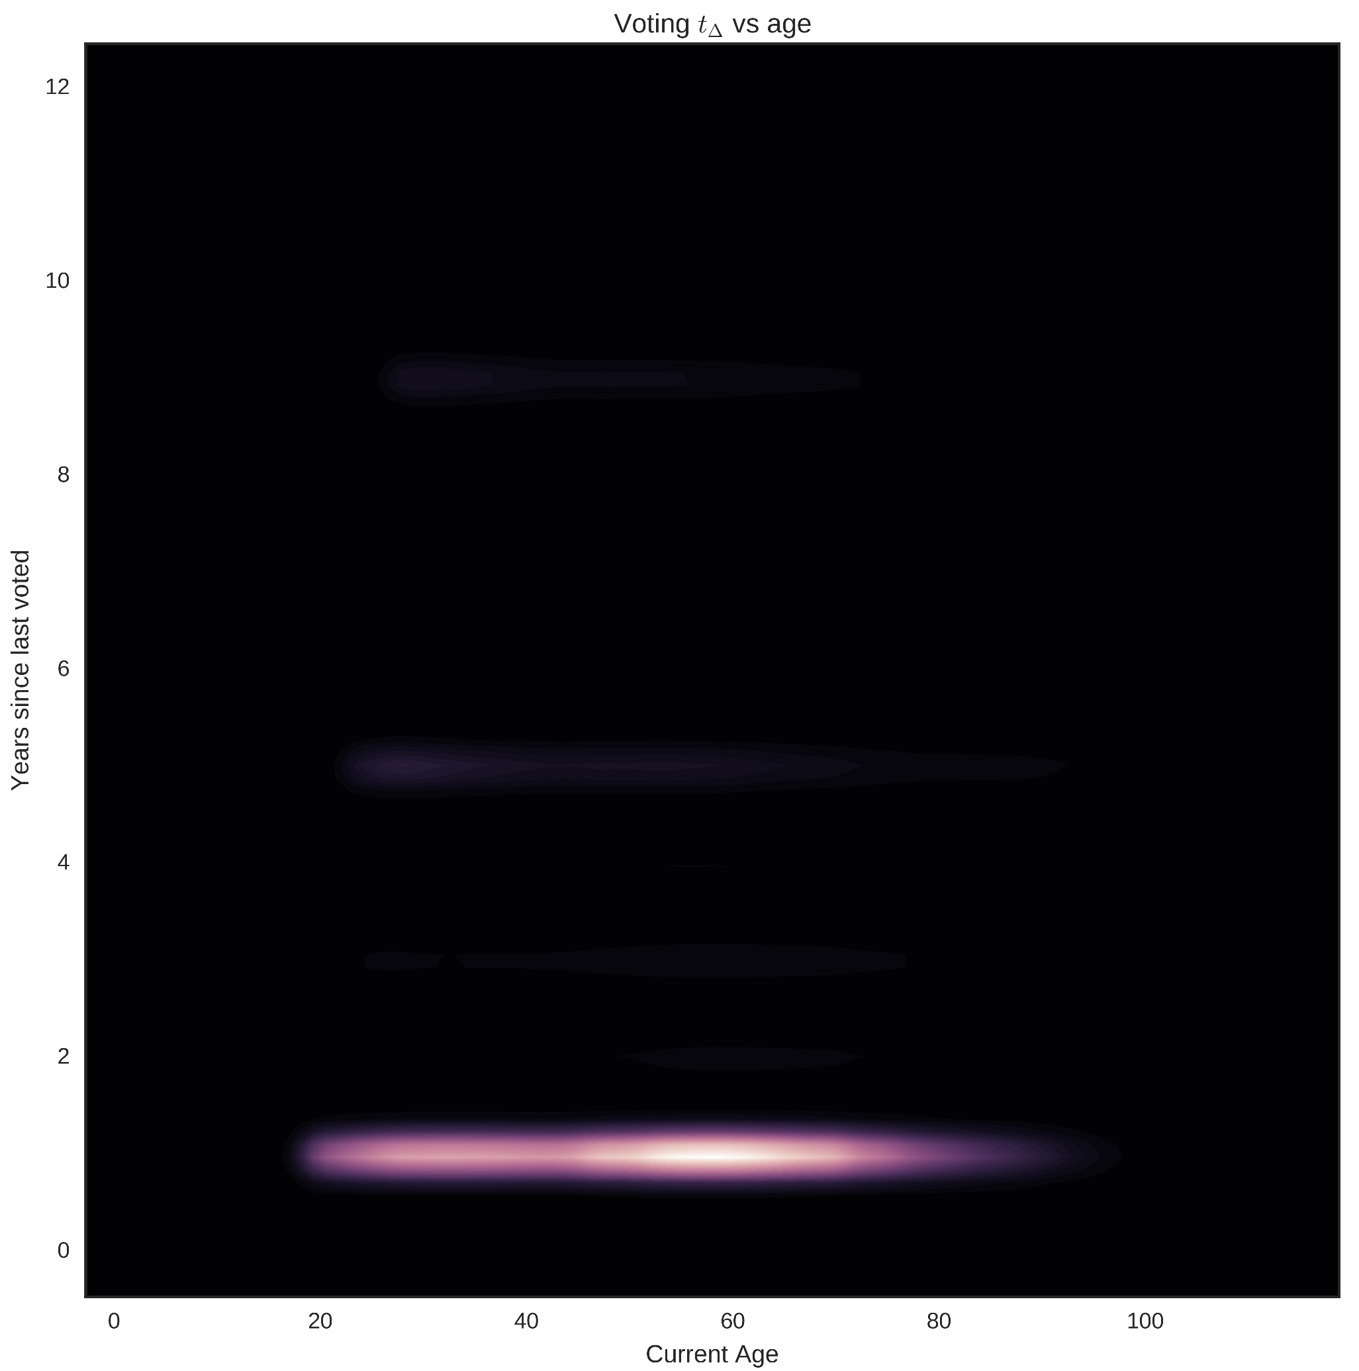
Current Voters

Slide 20
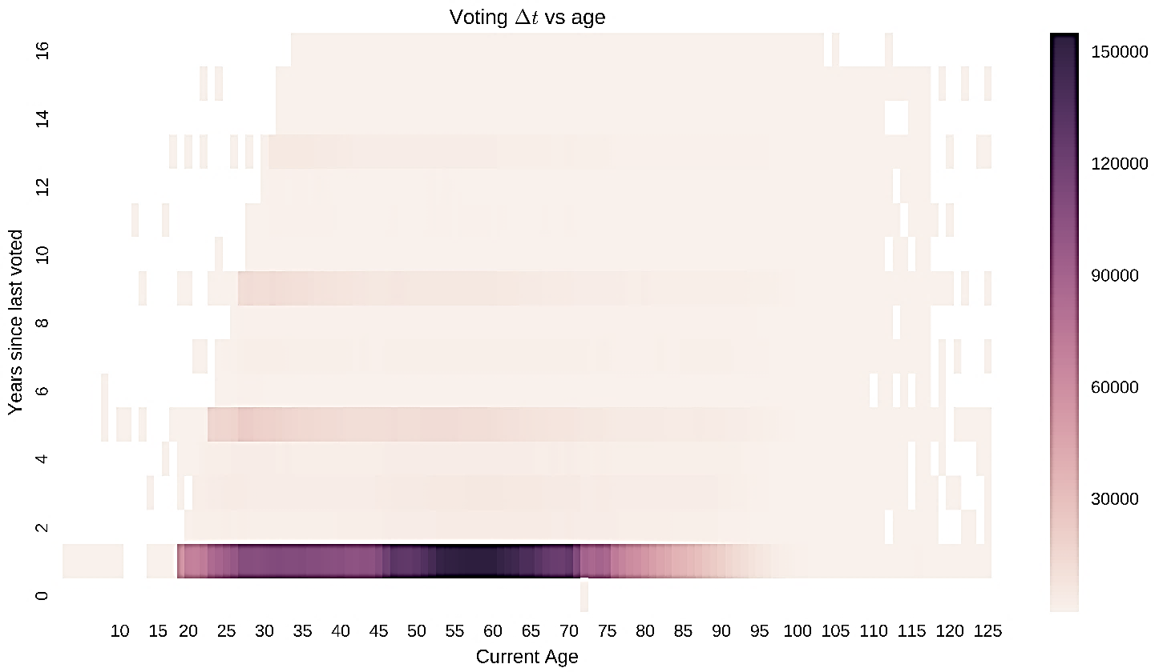
Current Voters
Years since last vote vs age

Slide 21
Current active voters (excluding 2016 voters)

Slide 22
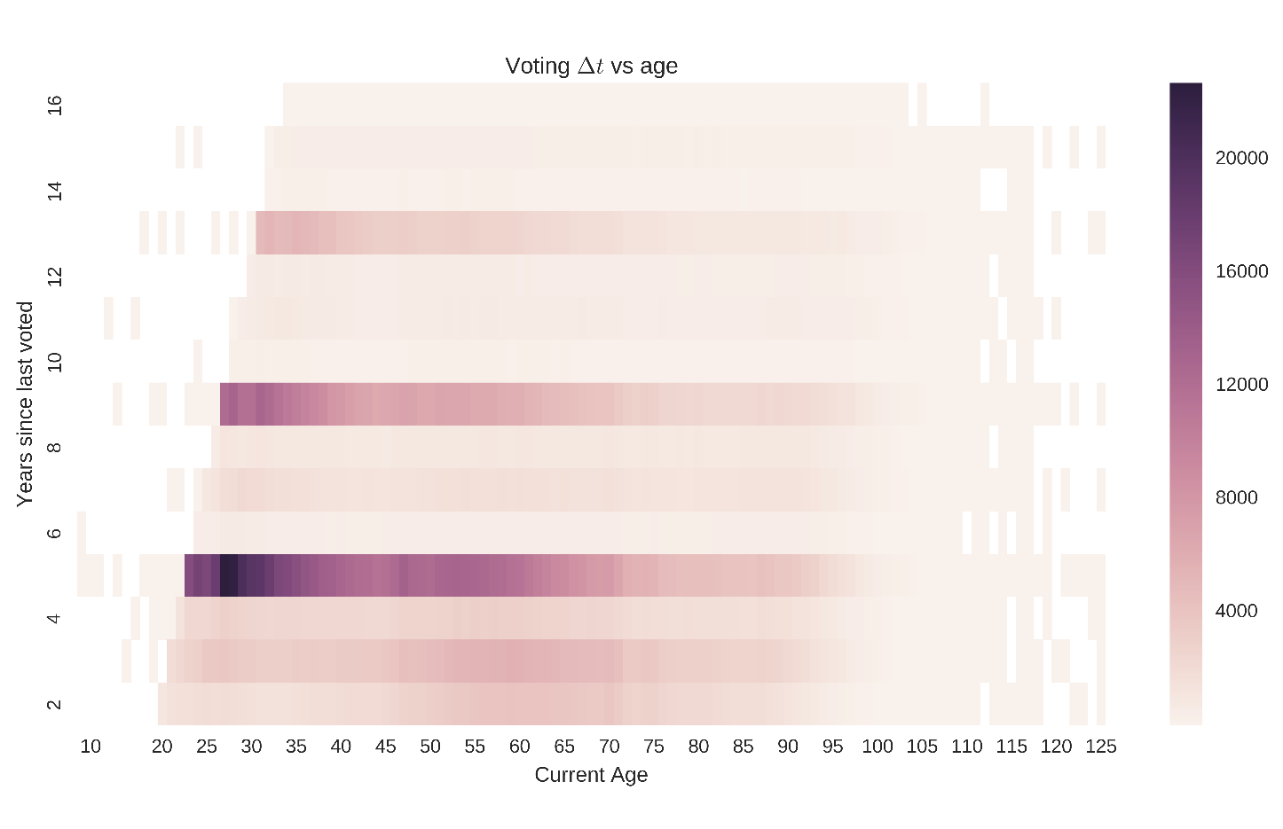
Current Voters (excluding 2016 voters)
Years since last vote vs age

Slide 23
Deliverables & Future work
01
02
03
04
Return voterID’s for people who may have been inaccurately purged and candidates for purging
System Errors
Exploring “OTHERS” Reason Code
Joining with ACS to visualize along similar lines

Slide 24
Thank You!

